Slide 1
Game Theory
By Zach Sanoian

Slide 2
History Behind Game Theory
Game theory was originally developed by mathematician Jon von Neumann and economist Oskar Morgenstern in 1944. The purpose behind game theory was to solve problems in the world of economics. The two observed that “economics is like a game, wherein players anticipate each other’s moves”. The theory can be applied to a wide variety of situations. Such applications include finding the optimal price to sell a product and who to select for a jury.

Slide 3
What is Game Theory?
Game theory is a branch of applied mathematics that provides tools for analyzing situations in which parties make decisions that are interdependent.
Each party, referred to as a player, must consider the other player’s possible decisions or strategies while formulating his own strategy.
A solution to a game describes the optimal decisions of the players, who may have similar, opposed, or mixed interests, and the outcomes that result from these different decisions.

Slide 4
Important Definitions
Game- a set of circumstances that has a result dependent on the actions of two or more players
Players- a strategic decision-maker within the context of the game
Strategy- a complete plan of action that a player will take given the set of circumstances that may arise within the game
Payoff- the payout a player receives for arriving at a particular outcome
Information set- information available at a given point in the game
Equilibrium- the point in the game where both players have made their decisions and an outcome is reached

Slide 5
Types of Games
Cooperative and Non-Cooperative
Normal Form and Extensive Form
Simultaneous Move Games and Sequential Move Games
Constant Sum, Zero Sum, Non-Zero Sum
Symmetric and Asymmetric

Slide 6
The Prisoner’s Dilemma
The Prisoner’s Dilemma is one of the most well-known concepts of game theory.
Ex) Two criminals are arrested for a crime and are interrogated separately. There is not enough evidence to convict the two criminals. The two criminals are unable to communicate with each other and are both presented with four different outcomes.

Slide 7
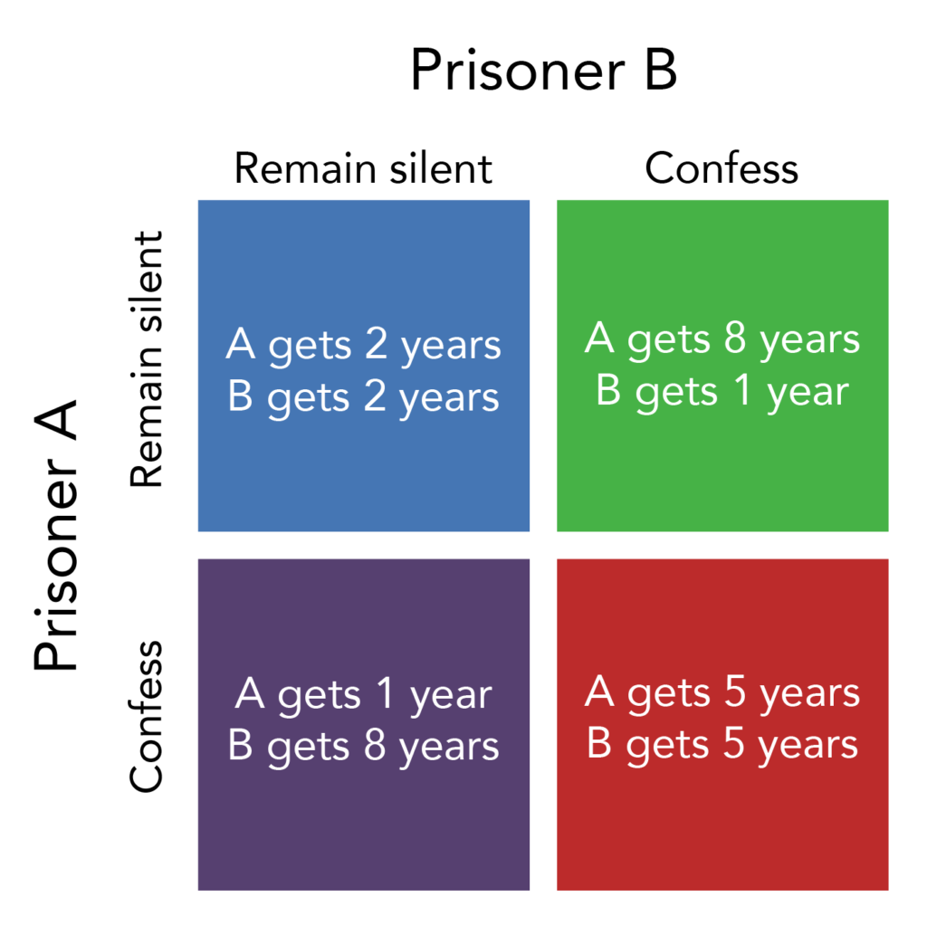
The Prisoner’s Dilemma
Both confess
Both prisoners receive 5 years
Prisoner A confesses, B does not
Prisoner A receives 1 year, B receives 8 years
Prisoner B confesses, A does not
Prisoner B receives 1 year, A receives 8 years
Neither prisoners confess
Both prisoners receive 2 years

Slide 8
So Which Option is Ideal?
The most favorable strategy for both prisoners is to keep silent and not confess. However, the catch is that neither prisoner knows if the other will confess or not. In all likelihood, both prisoners will end up confessing. This is because each prisoner will want to pick the option that is best for himself, not realizing that each will most likely end up serving 5 years each. This leads us into a discussion about Nash Equilibrium.

Slide 9
Nash Equilibrium
Nash equilibrium is a concept of game theory developed by mathematician John Nash. The concept is used to determine mathematically and logically the actions that the player of a game should take to secure the best possible outcome for himself. The optimal outcome is one in which no player feels the need to deviate from his chosen strategy after considering his opponent’s strategies and choices.

Slide 10
Cartel as a Prisoner’s Dilemma
Notes:
A cartel is an oligopoly in which the members try to collude to behave as a monopoly by setting prices and output to maximize the collective profit. ª The outcome for a cartel is a prisoner’s dilemma with a Nash equilibrium with each member doing the best it can, given the behavior of the others.
In this example, Venezuela and Nigeria have created an oil cartel. If they cooperate, the potential profit is $10 million dollars, evenly divided. If they both cheat, the maximum profit is only $8 million.

Slide 11
Cartel as a Prisoner’s Dilemma
Notes:
Although cooperation is the best outcome, there is a strong incentive to cheat to take advantage of the monopoly price. Examine the matrix on the left from Venezuela’s perspective: Venezuela’s optimal strategy is to cheat, regardless of what Nigeria does. If Nigeria cheats, Venezuela should cheat to get $4 million in profit; if Nigeria cooperates, Venezuela could get $6 million in profits.

Slide 12
Cartel as a Prisoner’s Dilemma
Notes:
Nigeria faces the same choices as Venezuela so its best strategy is also to cheat. The best outcome is in the lower right hand box of the matrix. This, however, is not a stable outcome. The outcome is indeterminate except that it will be a Nash equilibrium.

Slide 13
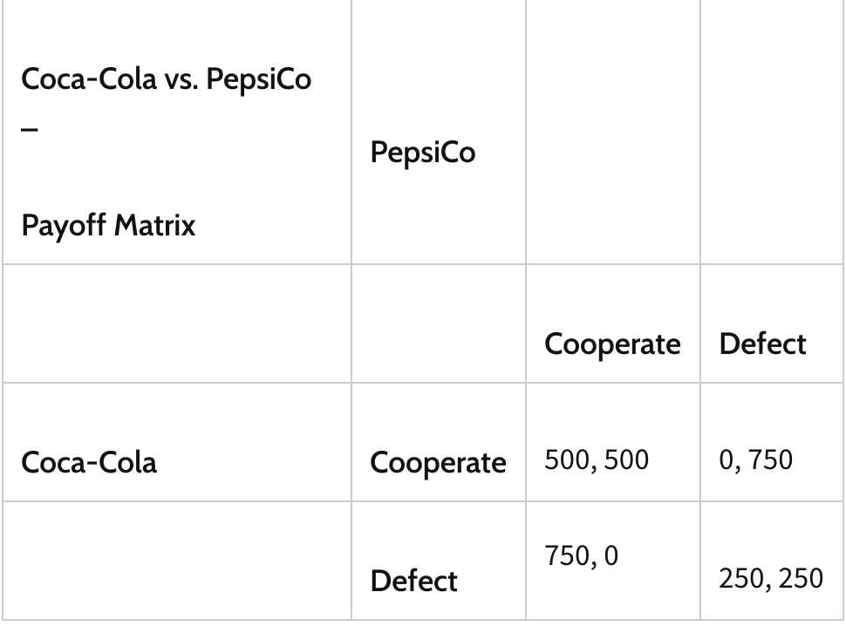
Coke vs. Pepsi
In this example, Coca-cola is considering cutting the price of it’s soda. Pepsi may have no choice but to do the same in order to retain its market share. Which is the ideal scenario?
Notes:
Let’s assume that the incremental profits that accrue to Coca-Cola and Pepsi are as follows:
If both keep prices high, profits for each company increase by $500 million (because of normal growth in demand).
If one drops prices (i.e., defects) but the other does not (cooperates), profits increase by $750 million for the former because of greater market share and are unchanged for the latter.
If both companies reduce prices, the increase in soft drink consumption offsets the lower price, and profits for each company increase by $250 million.

Slide 14
Resources
Davis, Morton D., and Steven J. Brams. “Game Theory.” Encyclopædia Britannica, Encyclopædia Britannica, Inc., 10 Jan. 2020, www.britannica.com/science/game-theory.
Hayes, Adam. “How Game Theory Works.” Investopedia, Investopedia, 5 Feb. 2020, www.investopedia.com/terms/g/gametheory.asp.
Picardo, Elvis. “The Prisoner's Dilemma in Business and the Economy.” Investopedia, Investopedia, 4 May 2020, www.investopedia.com/articles/investing/110513/utilizing-prisoners-dilemma-business-and-economy.asp.
Tomlinson, Steven. “Understanding a Cartel as A Prisoner's Dilemma.” Economics with Steven Tomlinson, college.cengage.com/economics/0538797274_mceachern/student/lecture/8432.pdf.

